Slide 1
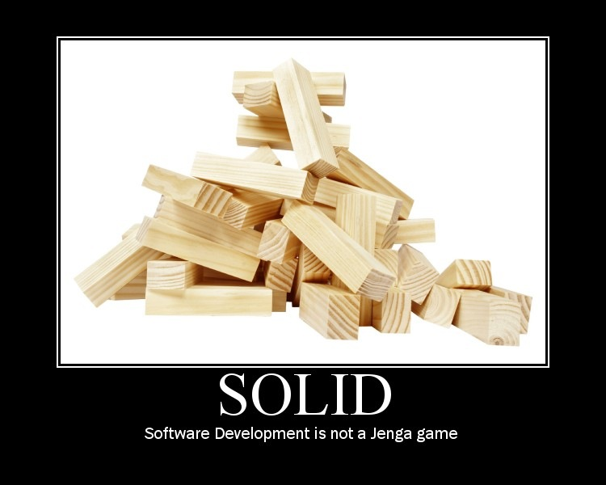

Slide 2
Writing SOLID Code
SOLID mnemonic acronym was formed to track Uncle Bob’s first five principles of OOP and OOD. They are:
Single Responsibility Principle (SRP)
Open-closed Principle (OCP)
Liskov Substitution Principle (LSP)
Interface Segregation Principle (ISP)
Dependency Inversion Principle (DIP)

Slide 3
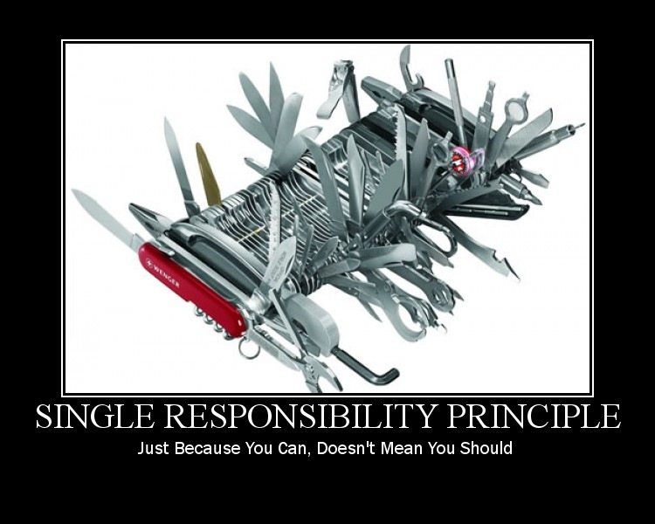

Slide 4

Single Responsibility Principle (SRP)
Responsibility
Set of related functionality or behavior that the class performs.
Each object in your application should have one and only responsibility.
And, each method (service) in that object should
focus on carrying out that single responsibility.
That responsibility should be entirely encapsulated by the context (class, function, variable)
All its services should be narrowly aligned with that responsibility
Uncle Bob further offers this rubric: Responsibility is a
reason to change

Slide 5

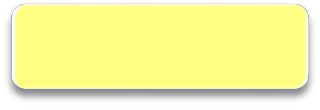
Single Responsibility Principle
Duck
Display()
Quack() Swim()
Fly()
Hunt()
Cook()
How many responsibilities does this class have?

Slide 6



SRP Analysis
Simple test to identify responsibility
The <_O_b je_c_t_> <_M e_th o_d_>Itself.
Follows SRP
The _^{D}_^{u}_^{c}_^{k}
The _D_u_c_k
The _D_u_c_k
The _^{D}_^{u}_^{c}_^{k}
The _D_u_c_k
The _D_u_c_k
_^{D}_^{is}_^{p}_^{la}_^{y}_^{[s}_] Itself.
_Q_u_a_ck_[s_] Itself.
_S_w_im_[_s_] Itself.
_^{F}_^{ly}_^{[s}_] Itself.
_H_u_n_t[_s] Itself.
_C_o_ok_s_[s_] Itself.

Slide 7

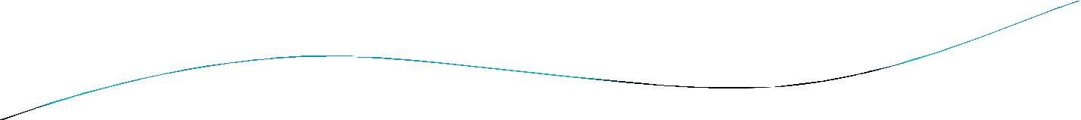




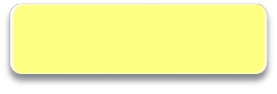
Refactoring Duck
Factor out unrelated behavior so that Duck ends up
with a single responsibility.
Duck
Display()
Hunter
Quack()
Swim()
Chef
Fly()
Hunt()
Cook()

Slide 8

Measuring SRP
FYI: Cohesion
Term used to measure how strongly the services i
your object support a single responsibility.
Architect Translation:
High Cohesion: Class designed around set of related
functionality
Low Cohesion: Class designed around set of
unrelated functionality
n

Slide 9

Why Bother?
WHY is it good for a class to have a single responsibility?
Each responsibility is area for potential change
Duck
Display()
Multiple responsibilities mean multiple reasons to change
changes to one responsibility may impair
the class’s ability to meet the others
may force rebuilding, retesting and redeployment of behavior not changed
Quack()
Swim()
Multiple responsibilities can impair reuse
opportunities
Multiple responsibilities can make class hard to understand
Multiple responsibilities can make class
delicate – hard to maintain
Fly()
Hunt()
Cook()

Slide 10
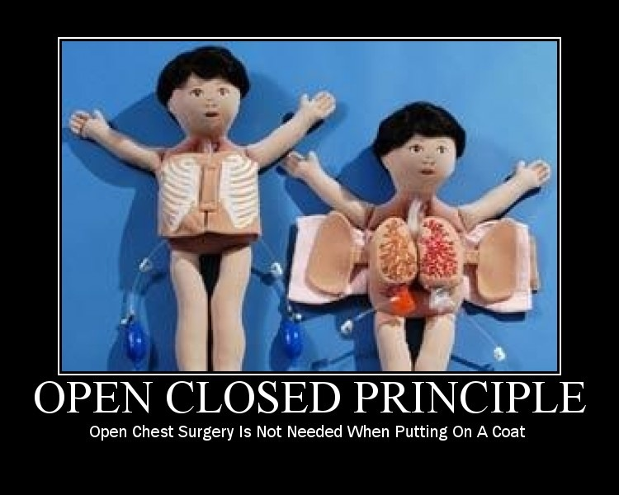

Slide 11
Open-closed Principle (OCP)
The OCP states that "software entities (classes, modules, functions, etc.) should be open for extension, but closed for modification“
Such an entity can allow its behavior to be modified without altering its source.
Code obeying this principle doesn't change when it is extended, and therefore needs no code reviews and unit tests outside of it’s extended functionality.

Slide 12
Open-closed Principle (OCP)
Two models for this exist
Bertrand Meyer’s model (early 90’s) which subclasses the implementation, but the interface may change – now called “implementation inheritance”.
Uncle Bob’s Model (’96) reuses interfaces through inheritance (abstract classes or interfaces) but not implementation code.
The existing interface is closed to modifications.

Slide 13
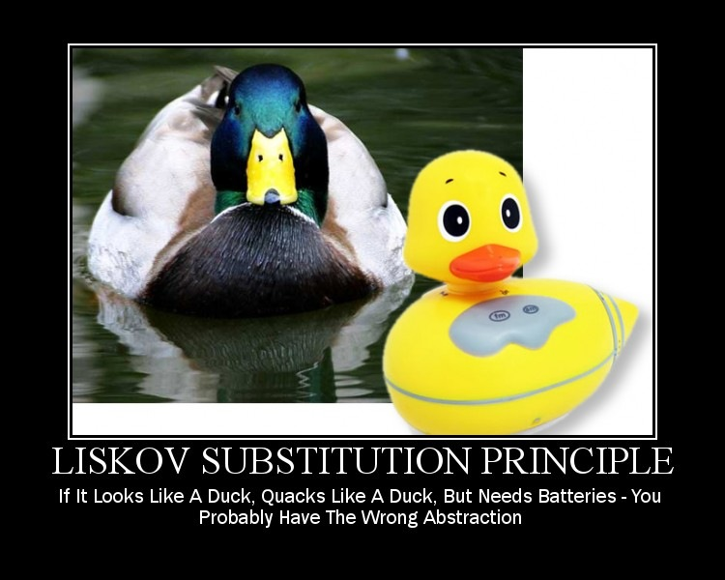

Slide 14
Liskov Substitution Principle (LSP)
Introduced by Barbara Liskov in 1988
States that, Derived classes must be substitutable for
their base classes
In other words…
Any code in which a specific class’ properties or methods are being used should work just as well with any class of that subtype
Makes code more robust and less coupled

Slide 15
Liskov Substitution Principle (LSP)
More abstractly speaking…
The LSP is a particular definition of a subtyping relation called (strong) behavioral subtyping
It defines a notion of substitutability for mutable objects
If S is a subtype of T, then objects of type T in a program may be replaced with objects of type S without altering the correctness of the code.

Slide 16
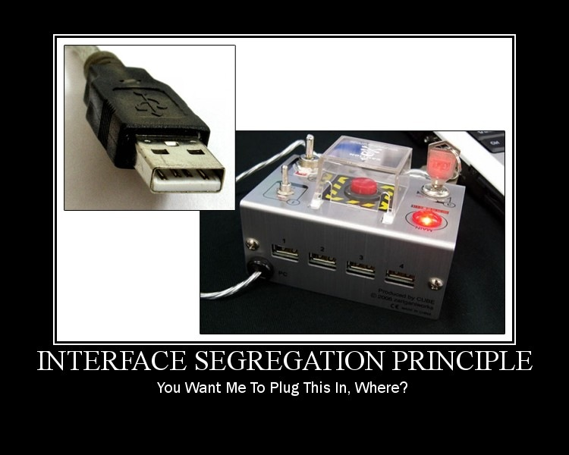

Slide 17

Interface Segregation Principle
(ISP)
States that, No client should be forced to depend on interfaces it does not use
In other words…
Do not put anything into an interface that each implementing class cannot use
Create a larger number of smaller interfaces
Such shrunken interfaces are also called role interfaces
The ISP is intended to keep a system decoupled and thus easier to refactor, change, and redeploy

Slide 18
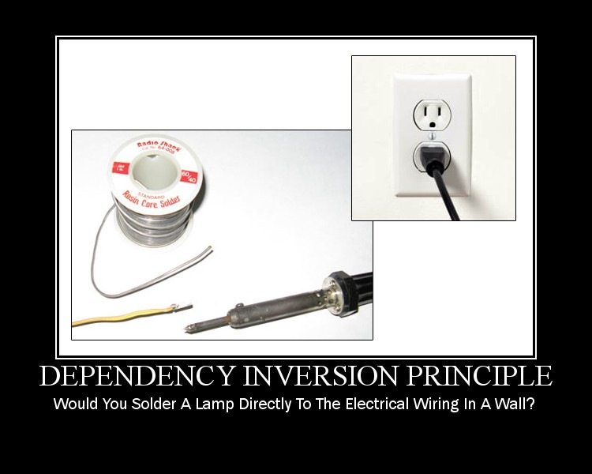

Slide 19

Dependency Inversion Principle
(DIP)
The DIP refers to a specific form of decoupling software modules.
Two key aspects to this:
High-level modules should not depend on low-level modules. Both should depend on abstractions.
Abstractions should not depend on details. Details should depend on abstractions.
Thus, both high- and low-level objects must depend on the same set of abstractions.

Slide 20
Lab
02 Lab - SOLID

